Slide 1

CRITIQUE OF VISUALIZATIONS
BY ZHOU RUOMIAO-1009611

Slide 2
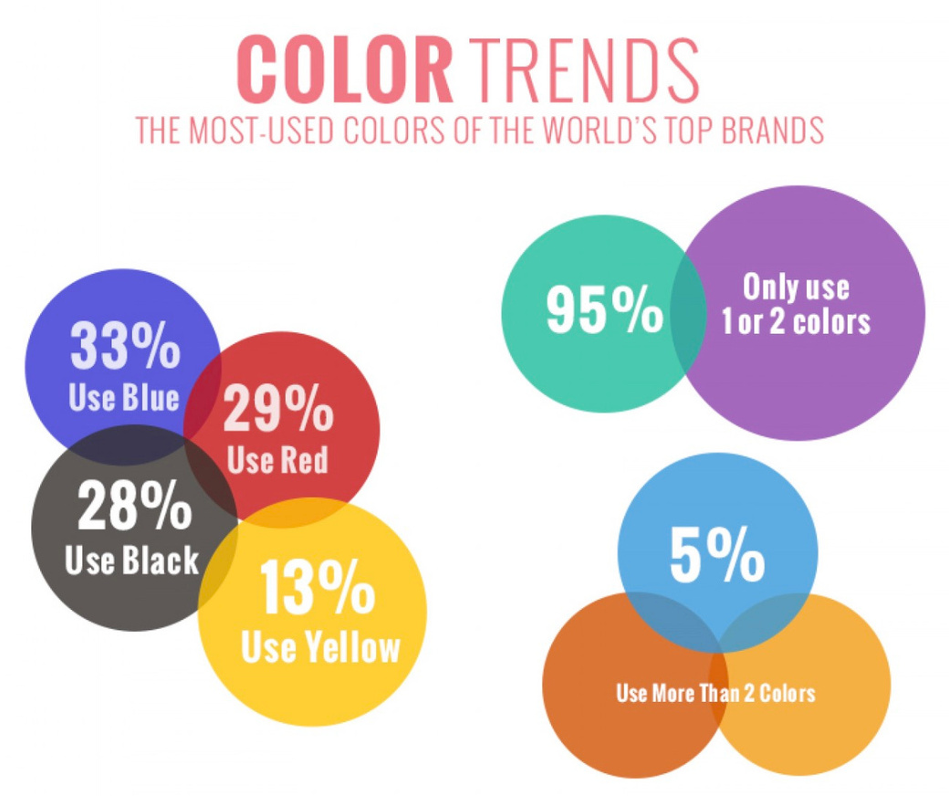
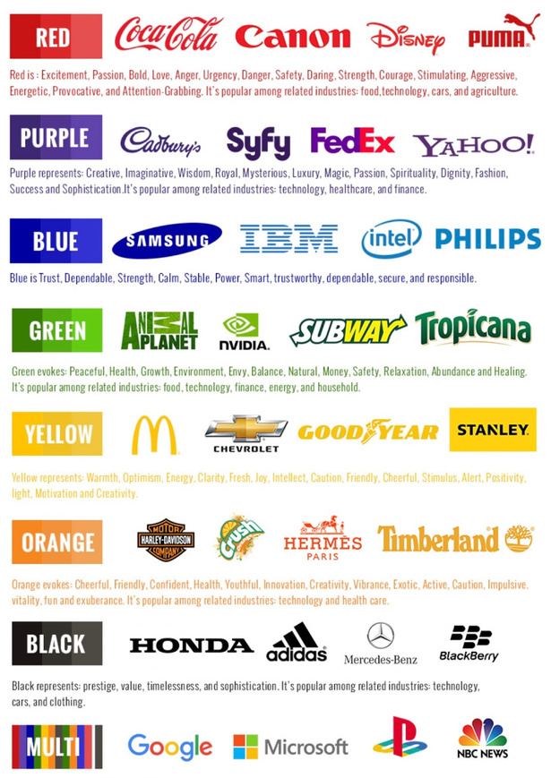
From: https://visual.ly/community/Infographics/other/what-your-brand-color-says-about-your-business
THIS GRAPHIC WAS CREATED BY AN AGENCY CALLED BLUEBERRY LABS. IT SHOWS THE MOST COMMON COLOURS USED BY BRANDS.

Slide 3
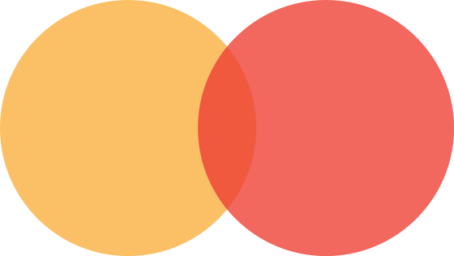
What’s wrong with it?
The size of the bubbles have no relationship with the values within them (e.g. why is 13% bigger than 28%?).
The overlap of bubbles can be misleading. (Does the overlap show me another relationship?)
The left shows the types of colors used, and the right shows the types of colors. But they use the same expression.

Slide 4
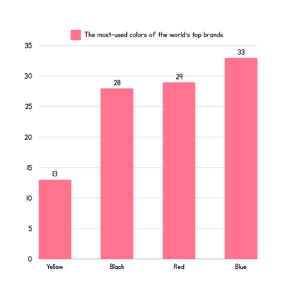
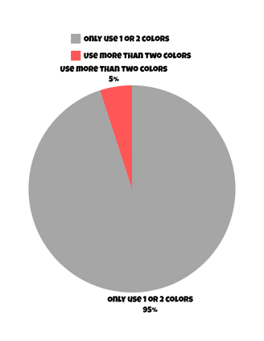

%
%
%
%
%
%
%
%
%
For the 4 bubbles on the left, the 4 colors were not mutually exclusive (as in, a brand can use more than 1 color). Because the 4 values don’t equal 100%. This means that the best way to represent this data would be through a bar chart.
The data on the right can be displayed using a pie chart.

Slide 5
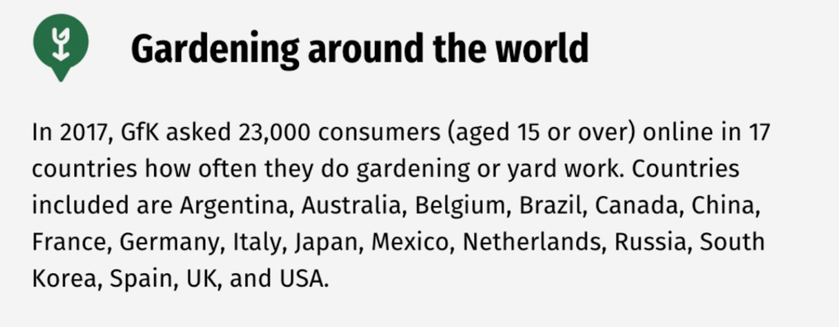
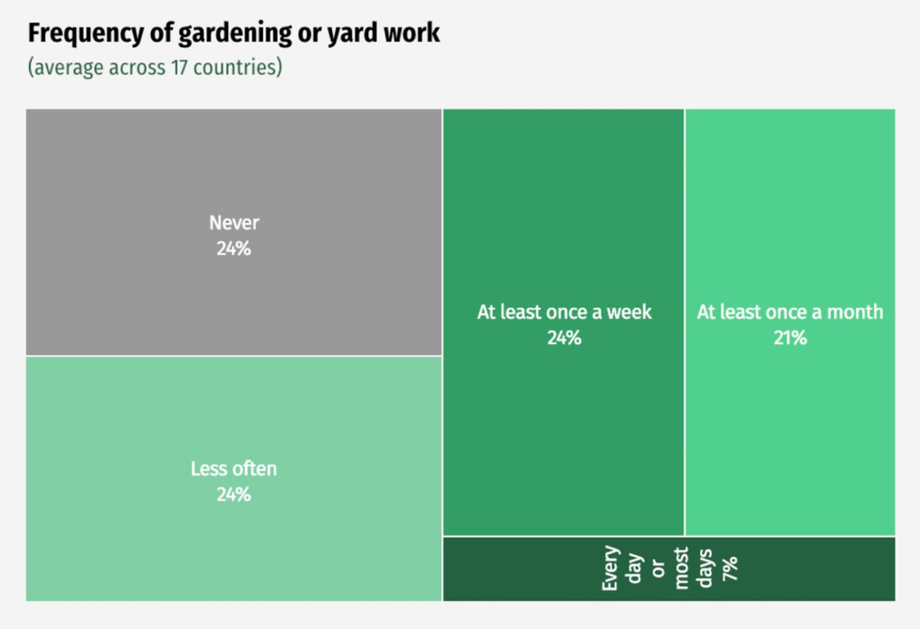
The graphic is meant to visualize the frequency of consumers doing gardening work.
Use a unique graphic for no good reason.
The header "less often." Less often than what?
The shape and size ratio is not clear, and it is impossible to see which proportion is more and which is less.

Slide 6
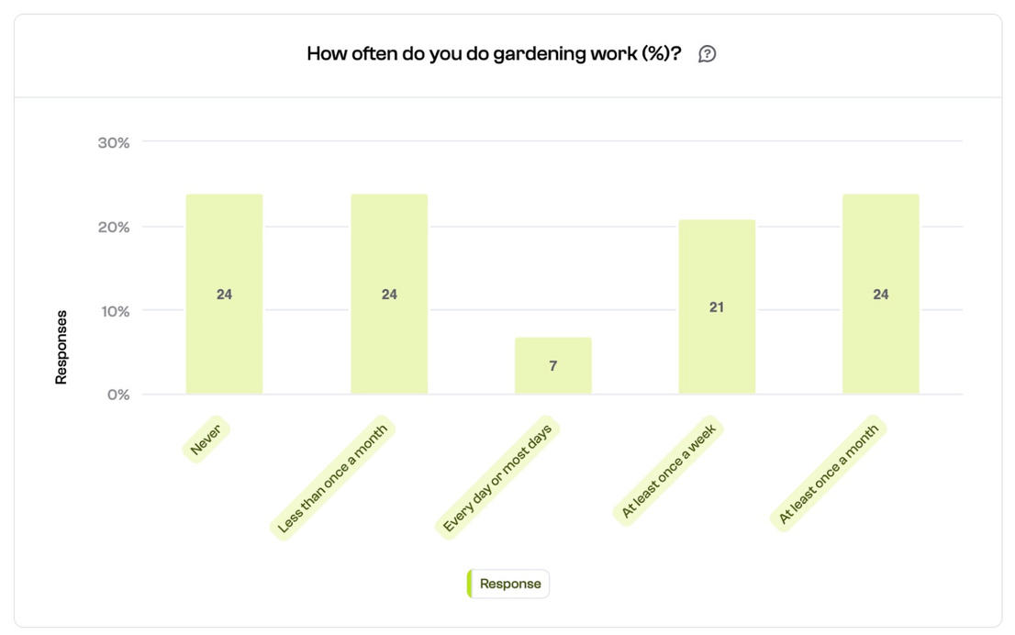
Apart from using a crystal-clear bar chart, the label "less often" is also replaced with "less than once a month." This eliminates any ambiguity from the visualization's message.

Slide 7
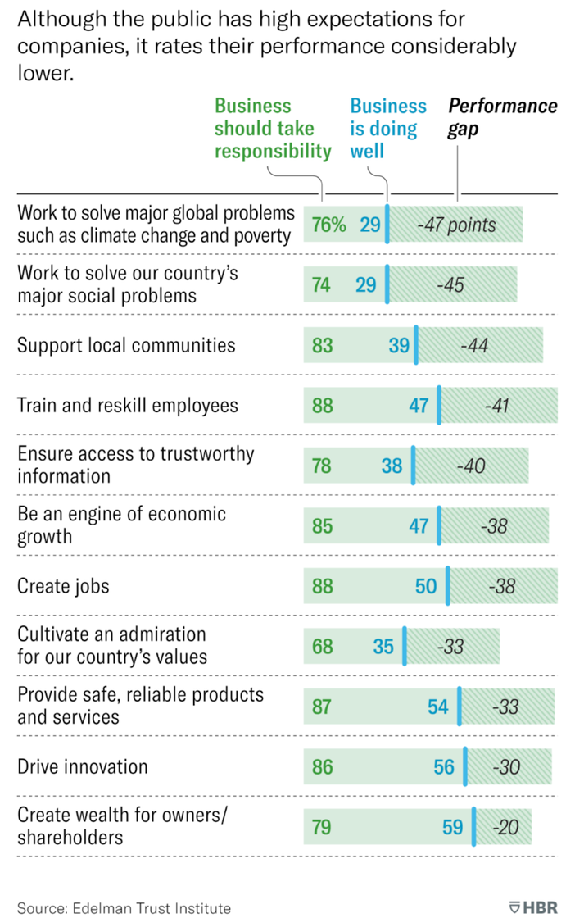
Insights:
the goal of the visualization above is to compare the public's expectations with the actual performance of businesses when it comes to specific issues.
The full green bar visualizes the "business should take responsibility" value. That's the percentage of respondents who believe the companies should be responsible for the items listed on the left (create jobs, drive innovation, support local communities, etc.).
The blue line in the middle marks the actual performance of the business in each expected responsibility. For example, when it comes to creating jobs, 50% of businesses are actually doing well.
the shaded part of the bar to the right is the performance gap. In simple terms, that's the difference between the performance of businesses and the expectations of the respondents.
Suggestions:
Rather than stacking both metrics in one bar, just create two bars for each. Otherwise, it will look a bit messy.
The left and right colors don't distinguish the data, they look the same. It would be better to distinguish them with different colors.

Slide 8
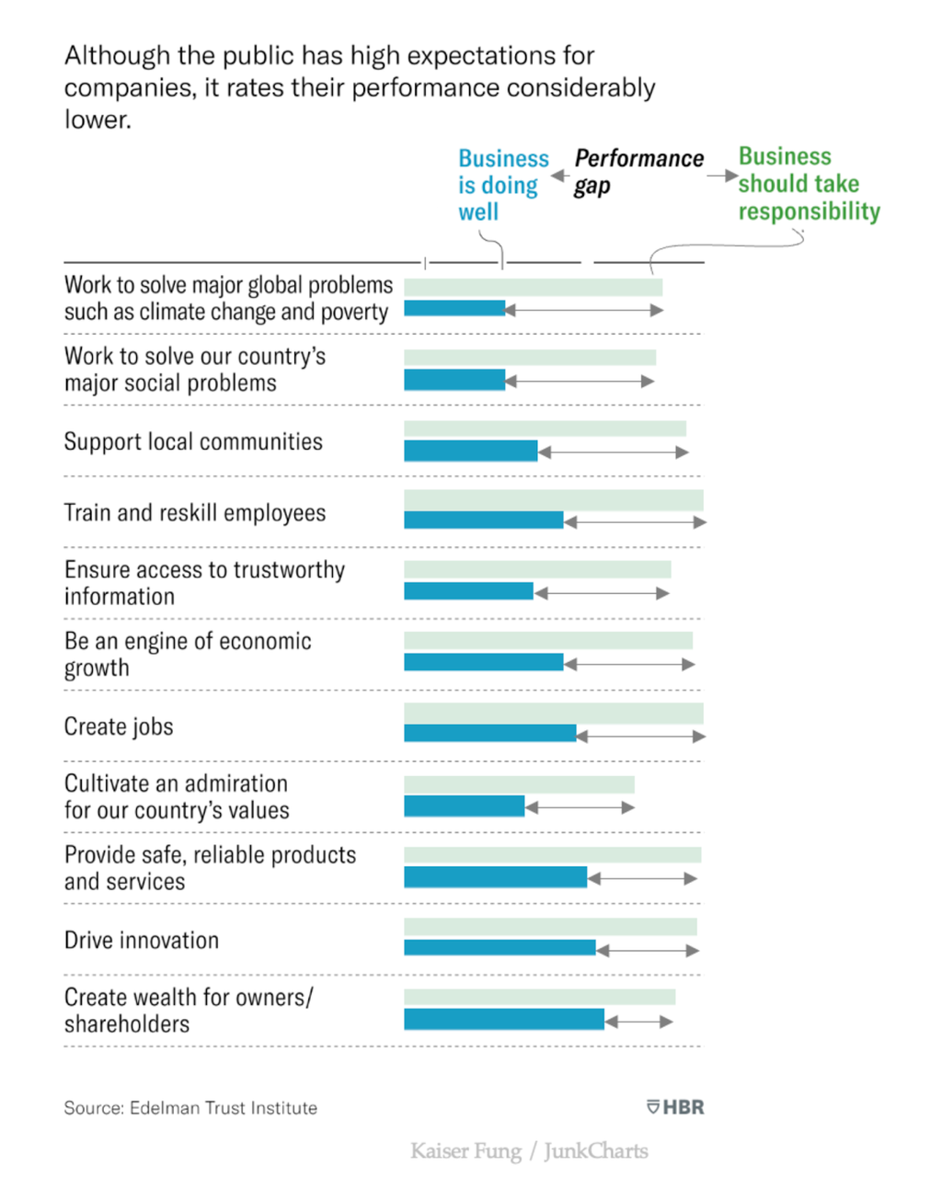

Slide 9

THANK YOU!
BY ZHOU RUOMIAO-1009611

